Slide 1

Media Monitoring
Multilabel Classification
Team: Binary Brigade
Presented by :
Prkhar Mishra
Aditi Chaturvedi
Notes:
Photo by Christina @ wocintechchat on Unsplash

Slide 2

Meet Sarah,
Business Analyst at a Media Monitoring company.
Sarah's categorizes and analyses daily printed media articles, offering topic-based insights to clients.
Notes:
Photo by Christina @ wocintechchat on Unsplash

Slide 3


Her desk frequently overflows with newspapers and magazines, a clear indication of the massive volume of articles she must manage.
Sarah's facing a significant challenge.
Reading and categorizing articles manually can be quite overwhelming.
Notes:
Photo by Christina @ wocintechchat on Unsplash

Slide 4
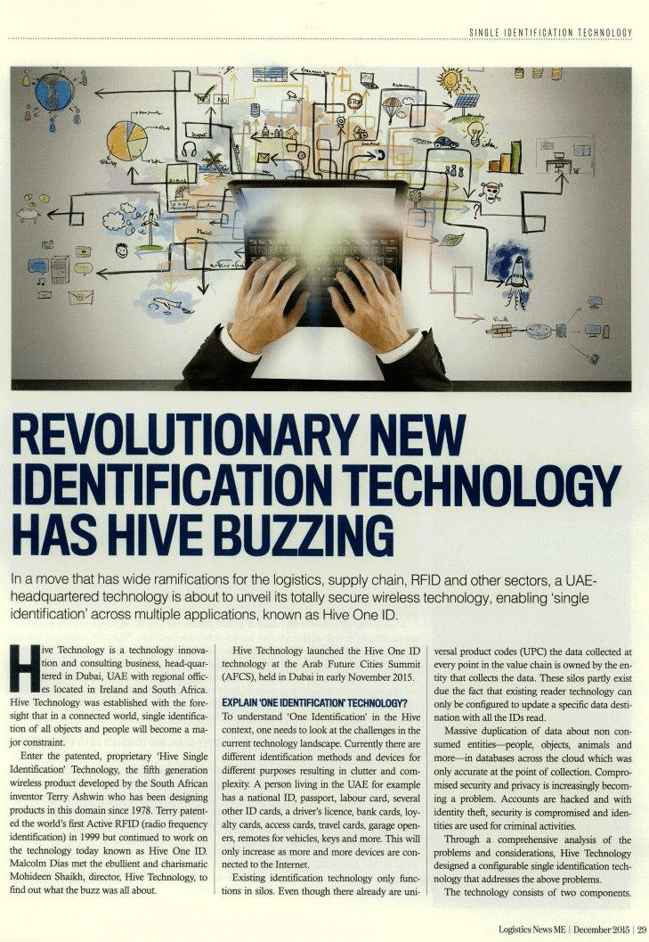
Applies tags like "Technology" and " "Business" based on her reading.
Time-consuming and provide less time for in-depth analysis.
Performing sentiment analysis manually is complicated.
Extracting key entities like organizations, events, and people is a tedious task.
Creating summaries for reports lengthens the process further.
Notes:
Photo by Christina @ wocintechchat on Unsplash

Slide 5

Sarah is looking for solution that transforms her workflow.
Enter the Automated Media Content Classification and Analysis System. Let's see how it works.
Notes:
Photo by Christina @ wocintechchat on Unsplash

Slide 6
Let's go through the flow charts.
Notes:
Photo by Christina @ wocintechchat on Unsplash

Slide 7















SOLUTION FLOW
Image
OpenCV Image Extraction
User provides Input(Text, Image, URL)
Data Pre-processing
URL
Web Scrapping with BeautifulSoup
Input is
Text
BERT Multi Label Classifier
Input is passed to API
Sentiment Analyzer
Output is displayed through API
All output is passed to API
User
Web Interface
(Using REACT)
Django REST API
Keyword Extraction(Organization, Events, etc.)
BERT Summarizer
7

Slide 8

Sarah can now focus on providing valuable insights
Notes:
Photo by Christina @ wocintechchat on Unsplash

Slide 9
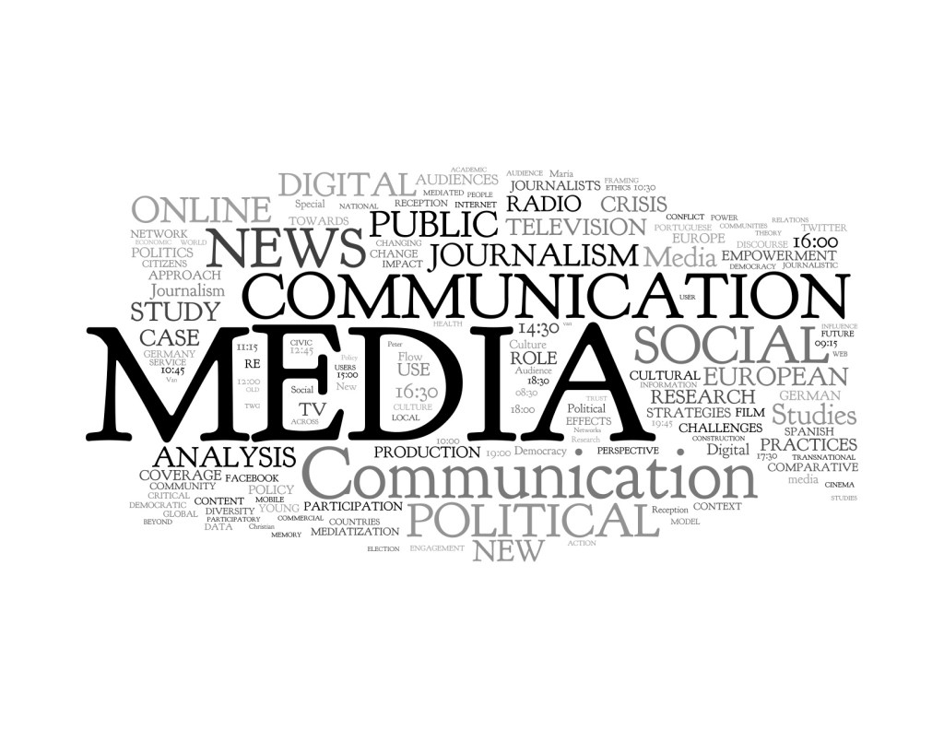
THANK YOU

